Slide 1

Developing a medical language model based on reasoning in Persian language
Mehrdad Ghassabi
Supervisor: Hamidreza Baradaran
Feb 2026

Slide 2
Summary
Gaokerena-R | Gaokerena-V
Mehrdadghassabi/Gaokerena-R | Mehrdadghassabi/Gaokerena-V | Github repository
1.0gaokerena/gaokerena-r | 1.0gaokerena/gaokerena-v | Model repository
2510.20059 | 2505.16000 | Arxiv id
70$ | 300$ | Cost
Yes | No | Reasoning capability
2025ICSPIS | 2025ICBME | Published in

Slide 3
Motivation
AI and language models are transforming healthcare
English models already provide expert-level medical Q&A
But Persian still lacks open, reliable medical language models
Building such models is crucial for privacy-friendly local deployment

Slide 4
Problem Statement
No Open Persian medical language models existed before
No Open Persian medical corpus, QA dataset and benchmark existed before
Facing almost a white paper on this topic

Slide 5
Phase 1

Slide 6
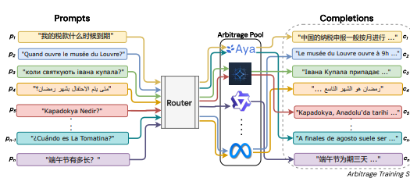
Baseline Model
Choosing a general purpose language model that support Persian
Almost all baseline models had problems understanding Persian
Aya-expanse was an exception since it had been developed to be

Slide 7
Collecting Data
Crawled 100k articles from 11 medical magazines
Crawled 186k free form QA pairs from 4 medical forums
Crawling Codes were running about two weeks
Cleaning Process has been done after crawling
Created benchmark by translating from english

Slide 8
Collected data summary
Medical Corpus 100k articles 90M tokens
Multiple Choice Question 11k for train 1.7k for dev 1.3k for test
Free Form Questions 186k before cleaning 22k train 2k dev 2k test

Slide 9
Training
Training on collected data lasted for 20 hours using a A100 GPU
About 3300 questions should be asked for testing using a L4 gpu
Each question answered in about 10s
In colab plans, A100 costs about $1 per hour and L4 costs about $0.5 per hour
Therefore Each train and test iteration costed about $25 for us
We found the best hyperparameters in 6 iterations

Slide 10
hyperparameters
Instruction-tuning | Fine-tuning
All linear layers | All linear layers | Target modules
2 | 2 | Batch size
16 | 16 | Gradient accumualtion
AdamW | AdamW | Optimizer
0.0005 | 0.0005 | Learning rate
0.3 | 0.3 | Max gradient norm
0.03 | 0.03 | Warm up ratio
0.5 | 0.1 | Weight decay ratio
1024 | 1024 | Max Context length
Left side padding | Left side padding | Padding Strategy
2 | 8 | Lora rank
2 | 16 | Lora alpha
0.4 | 0.05 | Drop out rate

Slide 11
Results
PersianMind | Qwen | aya-expanse | gaokerena-V
25.18 | 41.48 | 40.74 | 48.14 | Anatomy
34.0 | 52.0 | 49.0 | 53.0 | Genetics
20.23 | 43.35 | 44.51 | 43.93 | College-Medicine
25.28 | 47.92 | 52.07 | 55.47 | Clinical-Knowledge
23.89 | 43.01 | 45.58 | 47.05 | Professional-Medicine
32.63 | 42.36 | 45.14 | 47.22 | College-Biology
25.89 | 45.17 | 46.64 | 49.31 | Avg
19.64 | 33.33 | 34.52 | 38.69 | IBMSEE Sept 2023
b6.8 | b7.6 | b8 | b8 | No. parameters

Slide 12
Phase 2

Slide 13
Reasoning in language models
In NeurIPS 2019 Bengio asserted a key deficiency in current deep learning systems, they can't reason
That's why Sutton bitter lesson repeats
That deficiency exists in transformers too, a new artchitecture should be developed
But as Feb 2026 we are bounded to use transformers and try to enhace its reasoning skills

Slide 14
Enhacing reasoning in language models
The zeroth approach tries to use merge connectionist AI and Symbolic AI
The first approach which Bengio has suggested is to develop a new architecture within internal reasoning capability
The second approach is to guide the model in the inference time using PRM,ORM
The third approach is to train a language model using reasoning data an endeavour to mimic reasoning abilities.

Slide 15
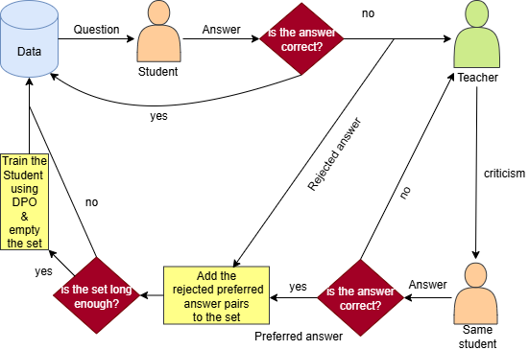
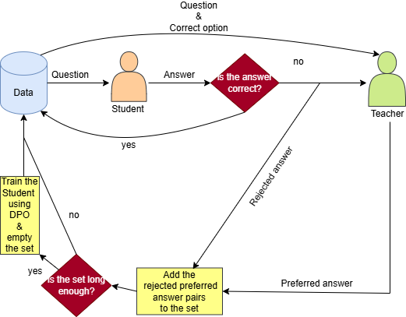
Proposed methods

Slide 16
Advantages
Without collecting data and just using RLAIF we got better Result
Only a Single hour has been used for training
Our experiments shows the importance of reasoning in medical domain

Slide 17
Result
aya-expanse | Gaokerena-V | Gaokerena-R
40.74 | 48.14 | 47.40 | Anatomy
49.0 | 53.0 | 56.0 | Genetics
44.51 | 43.93 | 50.28 | College-medicine
52.07 | 55.47 | 58.86 | Clinical-knowledge
45.58 | 47.05 | 48.89 | Professional-medicine
45.14 | 47.22 | 54.86 | College-biology
46.64 | 49.31 | 52.98 | Avg
34.52 | 38.69 | 46.42 | IBMSEE Sept 2023
Straight | Straight | Cot | Prompt
8b | 8b | 8b | No. parameters

Slide 18

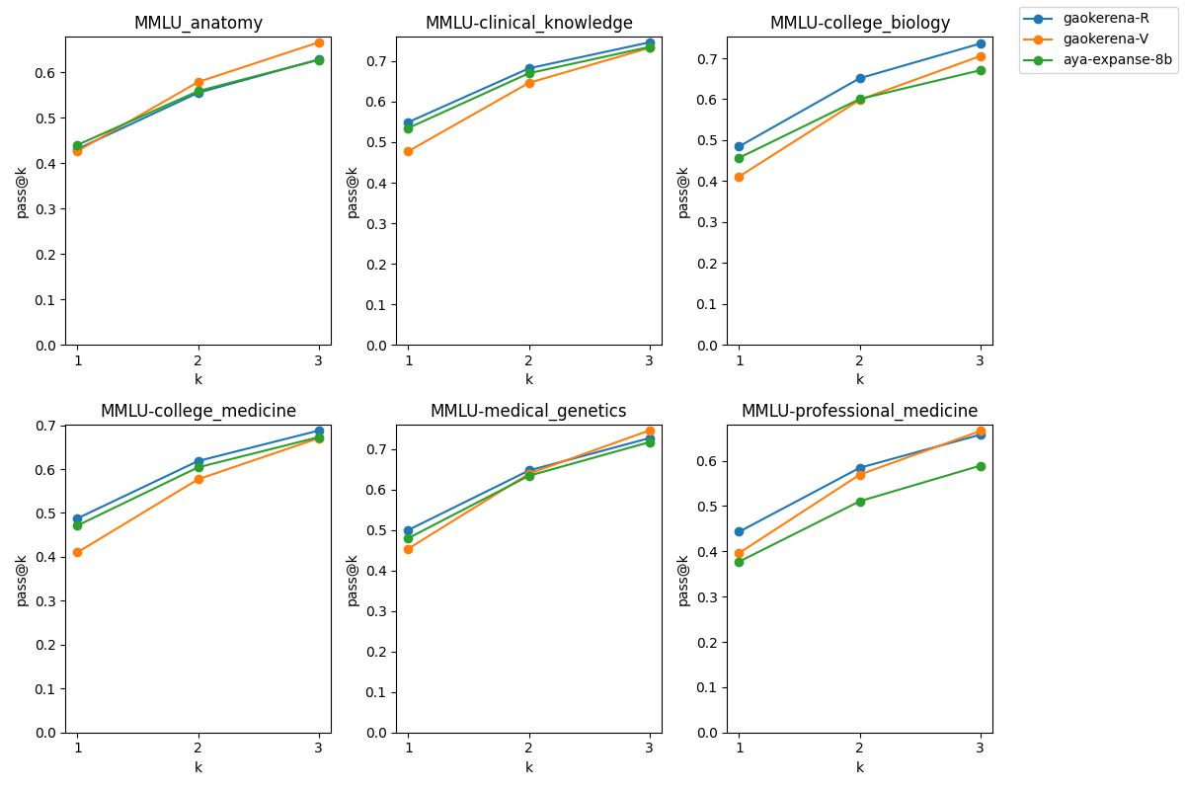
Results

Slide 19
Acknowledgement
My father and my family
Dr. Baradaran
Sadra Hakim
Pedram Rostami
Zahra Kazemi
Milad Tavakoli
Amirhossein Poursina
All audience in the presentation session

Slide 20
References

